Slide 1
Microcorruption CTF New Orleans

Slide 2

https://microcorruption.com

Slide 3
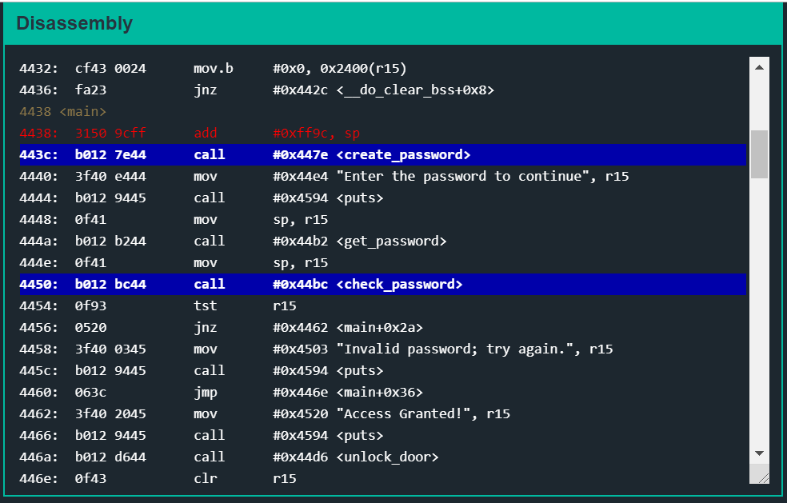
First, check on ‘main’ function and find two suspicious functions ‘create_password’ and ‘check_password’

Slide 4
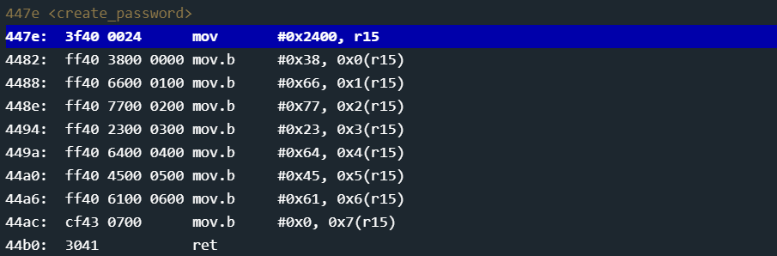
In ‘create_password’, find out that we load 8 bytes into memory location at 0x2400

Slide 5
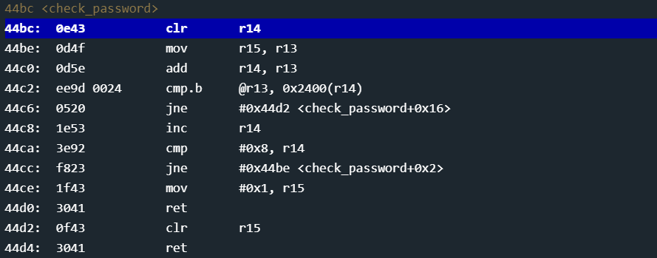
cmp.b : compare the memory location pointed to from r13 with the byte located at memory address 0x2400
Notes:
r13: input
0x2400: createpassword

Slide 6
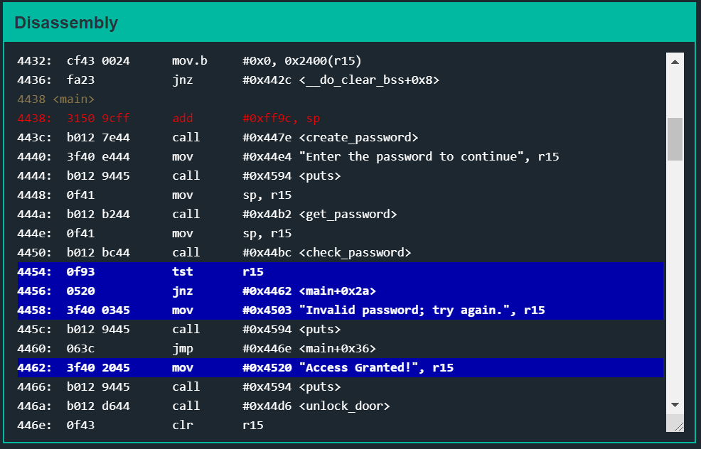
To get “Access Granted!” try to make r15 != 0

Slide 7
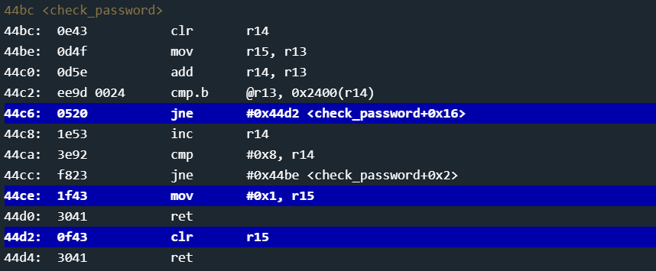
To avoid jumping to instruction on 0x44d2
the input should be exactly the same as the contents in 0x2400~0x2400+8bytes
which is created in ‘create_password’

Slide 8
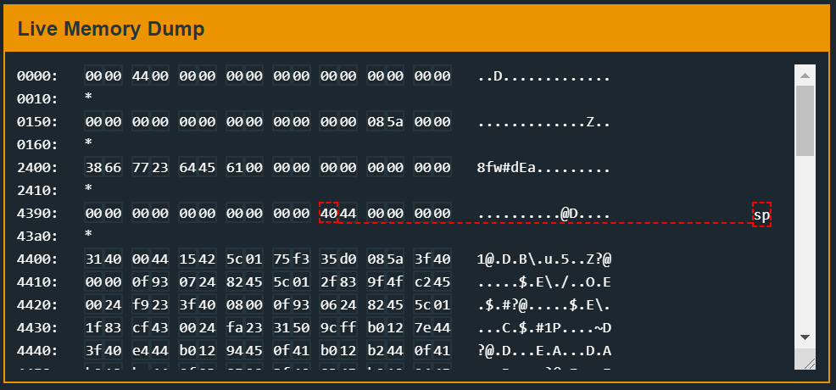
The input should be ‘8fw#dEa’

